Slide 1
PHYSICAL EXAMINATION OF GI SYSTEM.
DR.ARUN R NAIR
Dept. Of PRACTICE OF MEDICINE.

Slide 2
Rectus abdominis
Muscle.
Umbilicus
Inguinal ligament
Pubic tubercle
Xiphoid process
Costal margin
Midline, overlying
linea alba
Iliac crest
Anterior superior
iliac spine
Symphysis pubis

Slide 5
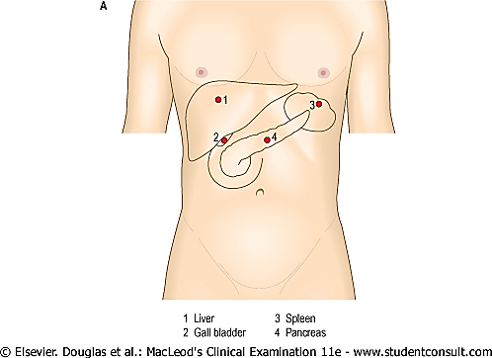
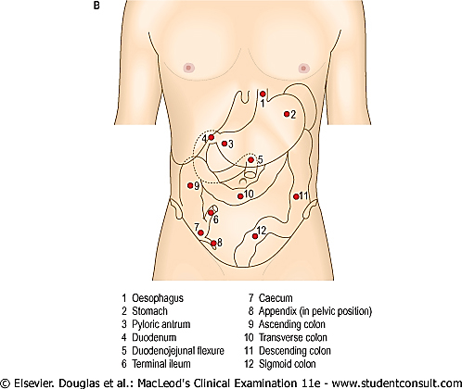

Slide 6
COMMON
SYMPTOMS
GENERAL
Anorexia
Weight loss
Pain - (Constant, colicky, local, generalized)
Abdominal -distension

Slide 7
SYMPTOMS G.I SYSTEM
XEROSTOMIA (Dry mouth)
WATER BRASH
(Sudden appearance of excessive saliva in the mouth)
PAINFUL LIPS, TONGUE AND MOUTH
DYSGEUSIA (Altered taste sensation)
DYSPHAGIA (Difficulty swallowing )
GLOBUS (Sensation of a lump in the throat)
ODYNOPHAGIA (Pain on swallowing )
HEARTBURN (Burning retrosternal discomfort radiating upward)
FLATULENCE (Belching )
DYSPEPSIA (Indigestion )
EARLY SATIETY (Premature fullness on eating)
NAUSEA
HAEMATEMESIS (Vomiting fresh or altered blood)
HICCUPS
Upper gastrointestinal

Slide 8
SYMPTOMS G.I SYSTEM
LOWER GASTROINTESTINAL
WIND
(Excessive/offensive flatus, or bloating/distension)
Altered bowel habit:
DIARRHOEA (Abnormally soft stools and/or frequent defecation)
CONSTIPATION (Abnormally firm stools and/or infrequent defecation)
STEATORRHOEA (Fatty stools, pale, greasy, difficult to flush away)
HAEMATOCHEZIA (Rectal bleeding)
MELAENA (Black, tarry stools)
HEPATOBILIARY
Jaundice (icterus)
Itch (pruritus)

Slide 9
PREPARATION OF PATIENT.
Lets go to..

Slide 10
Overview of the Abdominal Examination
Make sure that the patient is comfortable, then
“LOOK, LISTEN, THEN FEEL”.
                INSPECTION
                AUSCULTATION
                PERCUSSION
                PALPATION

Slide 11
General Considerations
The patient should have an empty bladder.
The patient should be lying supine on the exam table and appropriately draped.
The examination room must be quiet to perform adequate auscultation and percussion.
Watch the patient's face for signs of discomfort while entering the room onwards & during the examination.

Slide 12
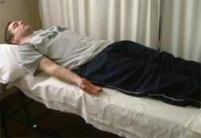
Patient position
The patient should be flat in the bed, with one pillow and legs/arms straight.
“Make sure that we wash our hands in the presence of the patient before beginning the examination. This is a subtle yet much appreciated gesture of concern for
the patient’s welfare.”

Slide 13
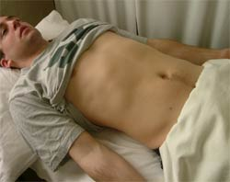
Patient exposure
The patient should be exposed from their nipples to the symphysis pubis.
The inguinal regions and external genitalia are also part of the full examination, but can be exposed at the appropriate time.

Slide 14
GENERAL PHYSICAL EXAMINATION INCLUDING VITAL SIGNS.
Lets go to..

Slide 15
A personal system for performing a physical examination
Handshake and introduction Note general appearances while talking: does the patient look well? any immediate and obvious clues, e.g. obesity, plethora, breathlessness complexion Hands and radial pulse Face Mouth Neck Thorax: breasts heart lungs Abdomen Lower limbs: oedema circulation Cranial nerves, Blood pressure Height and weight

Slide 16
Information from a handshake
Abnormal facial expressions
Cold, sweaty hands | Anxiety
Cold, dry hands | Raynaud's phenomenon
Hot, sweaty hands | Hyperthyroidism
Large, fleshy, sweaty hands | Acromegaly
Dry, coarse skin | Regular water exposure Manual occupation Hypothyroidism
Delayed relaxation of grip | Myotonic dystrophy
Deformed hands/fingers | Dupuytren's contracture Rheumatoid arthritis
Poverty of expression | Parkinsonism
Startled expression | Hyperthyroidism
Apathy, with poverty of expression and poor eye contact | Depression
Apathy, with pale and puffy skin | Hypothyroidism
Lugubrious expression with bilateral ptosis | Myotonic dystrophy
Agitated expression | Anxiety Hyperthyroidism Hypomania

Slide 17
inspection

Slide 18
INSPECTION
Starting from your usual standing position at the right side of the bed, inspect the abdomen. look at the contour of the abdomen and watch for peristalsis, it is helpful to sit or bend down so that we can view the abdomen tangentially.

Slide 19
Normal appearance
The abdomen is normally flat or slightly scaphoid and symmetrical.
At rest, respiration is principally diaphragmatic and the abdominal wall moves out with inspiration.
The umbilicus is usually inverted.
The liver edge may be felt below the right costal margin.
The aorta may be palpable as a pulsatile swelling above the umbilicus.
The lower pole of the right kidney may be palpable in the right flank.
The sigmoid colon may be palpable in the left iliac fossa, particularly if loaded with faeces.
A full bladder is palpable as a mass in the suprapubic region arising out of the pelvis and dull to percussion.

Slide 20
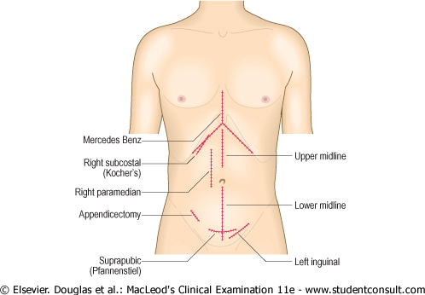
SKIN. SCARS AND STOMAS.
Note any surgical scars and clarify what they were for. They should be described in a standardized manner:
An appendicectomy scar lies diagonally in the right iliac fossa. Scars from hernia repairs are also diagonal but lower in either inguinal region.
A horizontal suprapubic scar, the Pfannenstiel incision, is used for gynaecological surgery.
A right subcostal scar usually signifies an open cholecystectomy while a bilateral subcostal scar with a vertical extension to the ziphisternum - known as a 'Mercedes-Benz' scar for obvious reasons - is the result of liver surgery.
A small infraumbilical incision is usually the result of previous laparoscopy.
Puncture scars from the ports used for laparoscopic surgery may be visible, e.g. in the right hypochondrium for laparoscopic cholecystectomy.

Slide 21
VISIBLE VEINS.
Abnormally prominent veins on the abdominal wall signify portal hypertension or vena caval obstruction. In portal hypertension this results from the recanalization of the umbilical vein along the falciform ligament.
DISTENSION/SWELLING.
The abdomen is distended and if so whether the distension is generalized or caused by a localized mass . In obesity the umbilicus is usually sunken, whereas in the other conditions it is flat or even projecting. Localized swelling, e.g. due to massive enlargement of liver or spleen, is best seen as asymmetry when you look at the patient from the foot of the bed.

Slide 22
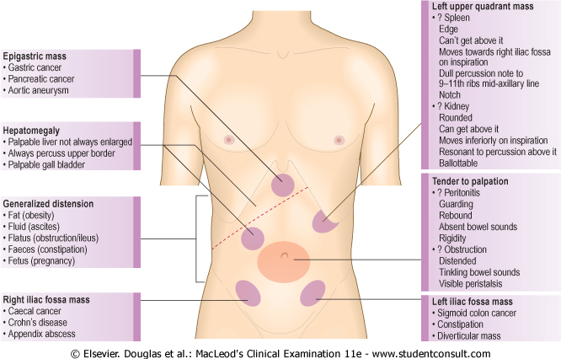

Slide 23
auscultation
Listen to the abdomen before performing percussion or palpation, since these maneuvers may alter the frequency of bowel sounds.

Slide 24
Place the diaphragm of stethoscope gently on the abdomen. Listen for bowel sounds and note their frequency and character. Normal sounds consist of clicks and gurgles, occurring at an estimated frequency of 5 to 34 per minute. Occasionally you may hear borborygmi—long prolonged gurgles of hyperperistalsis—the familiar “stomach growling.”
Because bowel sounds are widely transmitted through the abdomen, listening in one spot, such as the right lower quadrant, is usually sufficient.
Auscultation may also reveal bruits, vascular sounds resembling heart murmurs, over the aorta or other arteries in the abdomen, which suggest vascular occlusive disease.
You must listen for up to 2 minutes before concluding that they are absent. Absence of bowel sounds implies paralytic ileus or peritonitis.

Slide 25
In intestinal obstruction, bowel sounds occur at increased frequency and have a high-pitched tinkling quality.
Listen above the umbilicus over the aorta for bruits which indicate turbulent flow from atheroma or an aneurysm.
place the stethoscope 2-3 cm above and lateral to the umbilicus to listen for renal artery bruits as in renal artery stenosis.
Aorta
Renal artery
Iliac artery
Femoral artery
Notes:
A bruit in one of these areas that has both systolic and diastolic components strongly suggests renal artery stenosis as the cause of hypertension.

Slide 26
The liver for bruits which occur in hepatoma or acute alcoholic hepatitis. a friction rub in perihepatitis.
Very occasionally you may hear a venous hum in the upper abdomen over a caput medusa.
A succussion splash sounds like shaking a half-filled water bottle. Shake the abdomen by lifting the patient with both hands under the pelvis. Explain first what you are going to do. An audible splash more than 4 hours after the patient has eaten or drunk anything, indicates delayed gastric emptying, e.g. pyloric

Slide 27
percussion

Slide 28
percussion
Percuss the abdomen lightly in all four quadrants to assess the distribution of tympany and dullness.
Tympany usually predominates because of gas in the gastrointestinal tract, but scattered areas of dullness due to fluid and feces are also typical.
Any large dull areas that might indicate an underlying mass or enlarged organ. This observation will guide your palpation.
On each side of a protuberant abdomen, note where abdominal tympany changes to the dullness of solid posterior structures.
Briefly percuss the lower anterior chest, between lungs above and costal margins below. On the right, usually find the dullness of liver; on the left, the tympany that overlies the gastric air bubble and the splenic flexure of the colon.
Notes:
A protuberant abdomen that is tympanitic throughout suggests intestinal obstruction.
Dullness in both flanks indicates further assessment for ascites.

Slide 29
The Liver
Measure the vertical span of liver dullness in the right midclavicular line.Starting at a level below the umbilicus (in an area of tympany, not dullness),lightly percuss upward toward the liver. Ascertain the lower border of liver dullness in the midclavicular line.
Next, identify the upper border of liver dullness in the midclavicular line. Lightly percuss from lung resonance down toward liver dullness.
4 – 8 cm in midsternal line.
6 – 12 cm in right midclavicular
line

Slide 30
The span of liver dullness is increased when the liver is enlarged.
The span of liver dullness is decreased when the liver is small, or when free air is present below the diaphragm, as from a perforated hollow viscus.
Dullness of a right pleural effusion or consolidated lung, if adjacent to liver dullness, may falsely increase the estimate of liver size.
Gas in the colon may produce tympany in the right upper quadrant, obscure liver dullness, and falsely decrease the estimate of liver size.

Slide 31


The Spleen
When a spleen enlarges, it expands anteriorly, downward, and medially, often replacing the tympany of stomach and colon with the dullness of a solid organ. Percussion cannot confirm splenic enlargement but can raise suspicions of it.
Two techniques may help you to detect splenomegaly, an enlarged spleen:
Percuss the left lower anterior chest wall between lung resonance above and the costal margin (an area termed Traube’s space). This is variable, but if tympany is prominent, especially laterally,splenomegaly is not likely. The dullness of a normal spleen is usually hidden within the dullness of other posterior tissues.

Slide 32
Check for a splenic percussion sign. Percuss the lowest interspace in the left anterior axillary line, as shown below. This area is usually tympanitic. Then ask the patient to take a deep breath, and percuss again. When spleen size is normal, the percussion note usually remains tympanitic.
If either or both of these tests is positive, pay extra attention to palpating the spleen.
A change in percussion note from tympany to dullness on inspiration
suggests splenic enlargement. This is a positive splenic percussion sign.

Slide 33
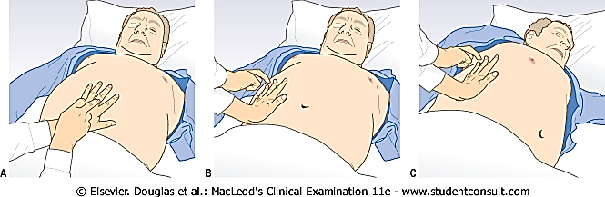
SHIFTING DULLNESS
This test is to demonstrate the presence of ascites. With the patient supine, percuss from the midline out to the flanks . Note any change from resonant to dull.
There are two methods : Keep our finger on the site of dullness in the flank and ask the patient to turn onto the opposite side. Pause for at least 10 seconds to allow any ascites to gravitate; then percuss again and if that area is now resonant, we have demonstrated shifting dullness as the ascitic fluid became dependent.
2. Mark the point at which the percussion note changes from resonant to dull with a pen on a line parallel to the flank. Ask the patient to turn to the same side and repeat the manoeuvre: if the line has moved 'up' the abdomen towards the midline, we have demonstrated shifting dullness.

Slide 34
Puddle Sign
Patient is made to adapt knee elbow position, in which periumbilical region become more dependent. Fluid collection in this can be demonstrated by dullness on percussion.It can be demonstrated if fluid in peritoneal cavity .

Slide 35
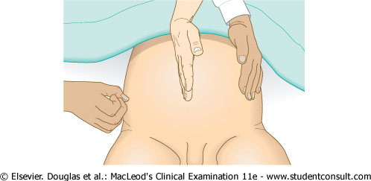
FLUID THRILL-Test for a fluid wave.
Place the palm of our left hand flat against the left side of the abdomen, flick a finger of your right hand against the right side of the abdomen. If we feel a ripple against our left hand, ask the patient (or an assistant) to place the edge of a hand on the midline of the abdomen . This prevents transmission of the impulse via the skin. If we still feel a ripple against our left hand this is a fluid thrill. This sign is only present when ascites is obvious.
we find central dullness and lateral resonance in a woman, suspect a giant ovarian cyst.

Slide 36
palpation

Slide 37
Examination Sequence
→ Ensure that your hands are warm. If the patient is in a low bed, sit on, or kneel beside, the bed on the patient's right side.
→ Ask the patient to place his arms alongside his body to help relax the abdominal wall. Placing a pillow under the patient's knees may also help by allowing flexion of the hips .
→ Ask the patient to show you where he feels pain before you start, and to report any tenderness as you examine him.
→ Begin with gentle superficial examination of the whole abdomen. If the patient has abdominal pain, start away from the site of maximal pain and move in a systematic manner through the nine regions of the abdomen.
→ Use your right hand, keeping it flat and in contact with the abdominal wall, and avoid using your finger tips. As you palpate, watch the patient's face for any sign of discomfort.
→ Palpate lightly in each region in turn, then repeat this palpating deeply.
→ Test muscle tone by light dipping movements with your fingers.

Slide 38
LIGHT PALPATION.
Feeling the abdomen gently is especially helpful in identifying abdominal tenderness, muscular resistance, and some superficial organs and masses. It also serves to reassure and relax the patient.
Keeping your hand and forearm on a horizontal plane, with fingers together and flat on the abdominal surface, palpate the abdomen with a light, gentle, dipping motion.
When moving your hand from place to place, raise it just off the skin.
Moving smoothly, feel in all quadrants.
Identify any superficial organs or masses and any area of tenderness or increased
Resistance to your hand. If resistance is present, try to distinguish voluntary
Guarding from involuntary muscular spasm.
Notes:
Feel for the relaxation of abdominal muscles that normally accompanies exhalation.
Ask the patient to mouth-breathe with jaw dropped open.
Voluntary guarding usually decreases with these maneuvers.

Slide 39
DEEP PALPATION.
using the palmar surfaces of your fingers, feel in all four quadrants.
Identify any masses and note their location, size, shape, consistency, tenderness, pulsations, and any mobility with respiration or with the examining hand.
Notes:
Abdominal masses may be categorized in several ways: physiologic (pregnant uterus), inflammatory (diverticulitis of the colon), vascular (an aneurysm of the abdominal
aorta), neoplastic (carcinoma of the colon), or obstructive (a distended bladder or dilated loop of bowel).

Slide 40
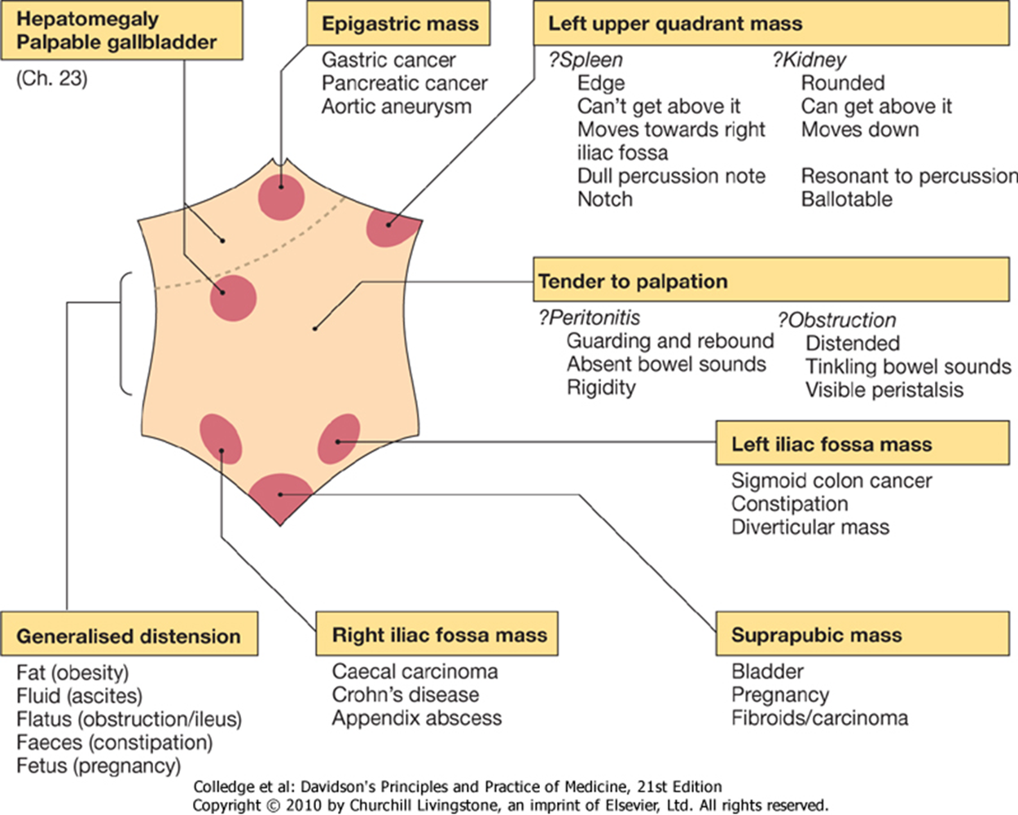

Slide 41
ASSESSMENT FOR PERITONEAL INFLAMMATION.
Localize the pain as accurately as possible. First, even before palpation, ask the patient to cough and determine where the cough produced pain. Then, palpate gently with one finger to map the tender area. Pain produced by light percussion has similar localizing value.
Look for rebound tenderness. Press your fingers in firmly and slowly, and then quickly withdraw them. Watch and listen to the patient for signs of pain.
Notes:
Abdominal pain on coughing or with light percussion suggests peritoneal inflammation.
Rebound tenderness suggests peritoneal inflammation. If tenderness is felt elsewhere than where you were trying to elicit rebound, that area may be the real source of the problem.

Slide 42
Abnormal findings
TENDERNESS.
Apparent tenderness in several areas with minimal pressure may be due to generalized peritonitis, but is often due to patient anxiety.
Severe pain with no tenderness on deep palpation, or where the tenderness disappears when the patient is distracted, suggests non-organic pathology.
Palpation which elicits pain may cause the patient to voluntarily contract the overlying abdominal muscles (voluntary guarding).
If the pain is due to inflammation, pressure of the parietal peritoneum Into the inflamed area results in a reflex contraction of the overlying muscles (involuntary guarding).
If the whole peritoneal cavity is inflamed there will be generalized peritonitis and the muscles of the anterior abdominal wall will be held rigid (board-like rigidity). The anterior abdominal wall does not move with respiration and breathing becomes increasingly thoracic.

Slide 43
'Rebound' tenderness is a sensitive sign of intra-abdominal disease but not a reliable indicator of peritoneal irritation.
The site of the tenderness is important, e.g. tenderness in the epigastrium suggests peptic ulcer; in the right hypochondrium, cholecystitis; in the right iliac fossa, appendicitis.
PALPABLE MASS.
feel a mass decide if it is due to enlargement of an abdominal organ, or a separate mass. If the mass or lump seems superficial it may be within the anterior abdominal wall rather than the abdominal cavity. Ask the patient to tense the abdominal muscles by lifting the head; an abdominal wall mass will still be palpable, whereas a deep mass will not

Slide 44
PALPATION OF LIVER
Place left hand behind the patient, parallel to and supporting the right 11th and 12th ribs and adjacent soft tissues below. Remind the patient to relax on your hand if necessary. By pressing your left hand forward, the patient’s liver may be felt more easily by your other hand.
Place our right hand on the patient’s right abdomen lateral to the rectus muscle, with your fingertips well below the lower border of liver dullness. Ask the patient to take a deep breath. Try to feel the liver edge as it comes down to meet your fingertips. If we feel it, lighten the pressure of our palpating hand slightly so that the liver can slip under your finger pads and we can feel its anterior surface. Note any tenderness. If palpable at all, the edge of a normal liver is soft, sharp, and regular, its surface smooth. The normal liver may be slightly tender.

Slide 45
Con’t..
On inspiration, the liver is palpable about 3 cm below the right costal margin in the midclavicular line.
An obstructed, distended gallbladder may form an oval mass below the edge of the liver and merging with it. It is dull to percussion.
The “hooking technique” may be helpful, especially when the patient is obese. Stand to the right of the patient’s chest. Place both hands, side by side, on the right abdomen below the border of liver dullness. Press in with our fingers and up toward the costal margin. Ask the patient to take a deep breath. The liver edge shown below is palpable with the fingerpads of both hands.

Slide 46
Con’t..
Assessing Tenderness of a Non-palpable Liver.
Place our left hand flat on the lower right rib cage and then gently strike our hand with the ulnar surface of our right fist. Ask the patient to compare the sensation with that produced by a similar strike on the left side.
“Tenderness over the liver suggests inflammation, as in hepatitis, or
congestion, as in heart failure.”

Slide 47
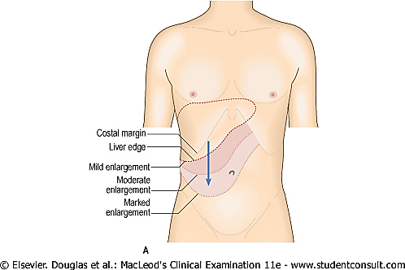
PALPATING AN ENLARGED LIVER
EXAMINATION SEQUENCE
→ Start palpating in the right iliac fossa.
→ Use either the radial border of our right hand, i.e. the outside edge of the forefinger, or the finger pads; in both cases keep our hand flat on the abdomen .
→ Keep our hand stationary and ask the patient to take a deep breath in. Try to feel the edge of the enlarged liver as it moves downwards on inspiration.
→ Move our hand progressively further up the abdomen a centimeter or so at a time repeating the request to breathe in until we reach the costal margin or detect the edge.

Slide 48

→ If we feel the liver edge, work out if it is enlarged or displaced downwards as occurs in patients with hyperinflated lungs from emphysema. The liver is dull to percussion whereas the lung is resonant, so locate the upper border of the liver by percussing over the right lateral chest wall. The lower three to four ribs are normally dull to percussion.
A reduced area of dullness suggests emphysema, a shrunken liver (as occurs in end-stage cirrhosis), or occasionally interposition of the transverse colon between the liver and the diaphragm.
→ Measure the distance below the costal margin in centimetres in the midclavicular line.

Slide 49
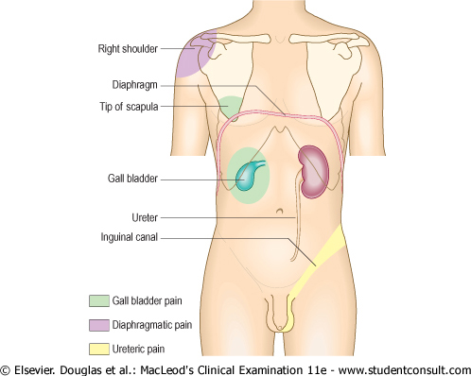

Slide 50
PALPATION OF THE SPLEEN
With our left hand, reach over and around the patient to support and press forward the lower left rib cage and adjacent soft tissue. With our right hand below the left costal margin, press in toward the spleen. Ask the patient to take a deep breath. Try to feel the tip or edge of the spleen as it comes down to meet our fingertips. Note any tenderness, assess the splenic contour, and measure the distance between the spleen’s lowest point and the left costal margin. In a small percentage of normal adults, the tip of the spleen is palpable.
Repeat with the patient lying on the right side with legs somewhat flexed at hips and knees. In this position, gravity may bring the spleen forward and to the right into a palpable location.

Slide 51
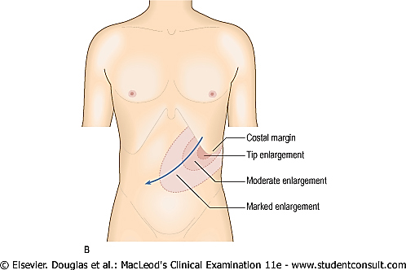
PALPATING AN ENLARGED SPLEEN
The spleen has to increase in size threefold to be palpable, so a palpable splenic edge always indicates splenomegaly. The spleen enlarges from under the left costal margin down and medially towards the right iliac fossa .If the spleen is significantly enlarged, a characteristic notch may be palpable midway along its leading edge.
Examination sequence
→ Start palpating in the right iliac fossa. If you start in the right hypochondrium, you may already be above the lower border of a massively enlarged liver.
→ Use either the radial border of your right hand, i.e. the outside edge of the forefinger, or the finger pads; in both cases keep your hand flat on the abdomen . Do not dig in with your finger tips as you may get a false impression of the liver edge.

Slide 52
THE KIDNEYS-PALPATION
“kidneys are not usually palpable”
Palpation of the Kidney.
Place our hand behind the patient just below and parallel to the 12th rib, with our fingertips just reaching the costo vertebral angle. Lift, trying to displace the kidney anteriorly. Place our opposite hand gently in the upper quadrant, lateral and parallel to the rectus muscle. Ask the patient to take a deep breath. At the peak of inspiration, press our left hand firmly and deeply into the left upper quadrant, just below the costal margin, and try to “capture” (ballotting) the kidney between our two hands. Ask the patient to breathe out and then to stop breathing briefly. Slowly release the pressure of our left hand, feeling at the same time for the kidney to slide back into its expiratory position.

Slide 53
Kidney Tenderness.
Note tenderness when examining the abdomen, but also search for it at each costovertebral angle. Pressure from our fingertips may be enough to elicit tenderness, but if not, use fist percussion. Place the ball of one hand in the costovertebral angle and strike it with the ulnar surface of our fist. Use enough force to cause a perceptible but painless jar or thud in a normal person.
To save the patient needless exertion, integrate this assessment with our examination of the back.
“Pain with pressure or fist percussion suggests pyelonephritis, but
may also have a musculoskeletal cause.”

Slide 54
The Bladder
The bladder normally cannot be examined unless it is distended above the symphysis pubis. On palpation, the dome of the distended bladder feels smooth and round. Check for tenderness. Use percussion to check for dullness and to determine how high the bladder rises above the symphysis pubis.
“Suprapubic tenderness in bladder infection”

Slide 55
THE AORTA
Press firmly deep in the upper abdomen, slightly to the left of the midline, and identify the aortic pulsations. The ease of feeling aortic pulsations varies greatly with the thickness of the abdominal wall and with the anteroposterior diameter of the abdomen.

Slide 56
AN INFLAMED APPENDIX
ROVSING’S SIGN.-
"The left hand is applied over the healthy colon in the left iliac fossa, the right hand applies pressure over it in an antiperistaltic direction; because the ileo-caecal valve is competent, pain is produced in the right iliac fossa with inflammation of the appendix and caecum. Where there is muscular rigidity in the right iliac fossa and therefore accurate palpation is impossible, it will give a clue to the diagnosis - that is, it will differentiate between a lesion of the caecum and the appendix in the right iliac fossa from another lesion“.

Slide 57
Psoas sign
The psoas sign is a medical sign that indicates irritation to the iliopsoas group of hip flexors in the abdomen, and consequently indicates that the inflamed appendix is retrocaecal in orientation (as the iliopsoas muscle is retroperitoneal). It is elicited by performing the psoas test by passively extending the thigh of a patient lying on his side with knees extended, or asking the patient to actively flex his thigh at the hip.[1] If abdominal pain results, it is a "positive psoas sign".
Obturator sign
A clinical finding in a Patient lying on his back with the right hip and knee flexed and rotated internally and externally; pain in the right lower quadrant is due to irritation of the medial internal obturator muscle, and is 'classically' associated with appendicitis, but may also occur in right pelvic abscesses , is a characteristic of infectious arthritis, & may be seen in traumatic hemorrhage

Slide 58
Murphy’s sign.
A sharp increase in tenderness with a sudden stop in inspiratory effort constitutes a positive Murphy’s sign of acute cholecystitis.

Slide 59
conclusion

Slide 60
Abdomen
Normal appearance flat, scaphoid and symmetrical.
Normal findings liver edge may be felt below the right costal margin.
Aorta may be palpable as pulsatile swelling.
Lower pole of the right kidney may be palpable.
Faecal mass may be palpable.
Distended bladder

Slide 61
Inspection
Skin striae, bruising or scratch marks.
distended veins superior vena cava, inferior vena cava and, portal hypertension (caput medusae).
Distension of abdomen. Generalised or localised.
Scars and stomas
Movements normal movements- still, silent abdomen in generalised peritonitis.
Epigastric palpation.
Visible peristalsis GOO, distal small bowel obstruction, normal very thin, elderly patients.
Pigmentation of skin -linea nigra
-erythema ab igne -- brown mottled pigmentation on the skin of abdominal wall.

Slide 62
Palpation, Percussion, Auscultation
Light palpation tenderness
rebound tenderness
palpable mass
Deep palpation enlarged organs,
liver, spleen, kidneys, gall
bladder.
Percussion liver, spleen, shifting dullness
fluid thrill.
Auscultation bowel sounds, aorta (above
umbilicus), renal bruits, liver bruits, rub
succussion splash.

Slide 63

Thanks..

